Slide 1
DSA 6000 Final Project Classification
Jonathon Kirles

Slide 2
Algorithms Chosen for Classification
Decision Tree – Good for feature selection, recursively builds the tree for decision making
Random Forests – Uses ensemble trees to mitigate overfitting and improve accuracy
Support Vector Machines – Excel at finding the best decision boundaries between classes in the data
Gradient Boosting Machine – Can combine and enhance sequentially built models to improve performance
C50 – can employ techniques such as boosting to improve model accuracy
Generalized Linear Model – good for a wide range of response variables, good for parameter estimation

Slide 3
Measures Chosen For 20 Datasets
Accuracy – The ratio of correctly classified data points
Precision – The true positive predictions compared to the total amount of predicted positives
Sensitivity – Shows how well a modle finds what it is looking for, helps us understand how often it is right when it says it has a positive instance
F1- A balance between precision and sensitivity, it considers both false positives and false negatives

Slide 4
Datasets
Dataset | Rows | Columns | Dataset Characteristics
Obesity levels based on eating habits | 30000 | 24 | multivariate
Default of credit card clients | 435 | 16 | multivariate
Congressional Voting Records | 48842 | 14 | multivariate
Income exceeds 50k | 704 | 21 | -
Autism screening for adults | 299 | 12 | multivariate
Heart failure clinical records | 4424 | 36 | tabular
Predict students dropout and academic success | 690 | 15 | multivariate
Credit Approval | 470 | 17 | multivariate
Thoracic | 432 | 6 | multivariate
MONKs problem | 303 | 13 | multivariate
Heart Disease | 625 | 4 | multivariate
Balance scale | 336 | 8 | multivariate
Ecoli | 440 | 8 | multivariate
Wholesale customers | 768 | 10 | multivariate
Energy efficiency | 520 | 17 | multivariate
Early stage diabetes risk prediction | 615 | 12 | multivariate
HCV data | 748 | 5 | multivariate
Blood transfusion service center | 961 | 6 | multivariate
Mammographic mass | 504 | 20 | -

Slide 5
Averages of Measures For Each Dataset
Dataset | Accuracy (percent) |  |  |  |  |  | Sensitivity (percent) |  |  |  |  |  | Precision (percent) |  |  |  |  |  | F1 (percent) |  |  |  |  |  | Time(in seconds)
 | DT | RF | SVM | C50 | GBM | GLM | DT | RF | SVM | C50 | GBM | GLM | DT | RF | SVM | C50 | GBM | GLM | DT | RF | SVM | C50 | GBM | GLM | DT | RF | SVM | C50 | GBM | GLM
Vegas | 71 | 75 | 72.6 | 74.3 | 75.7 | 68.4 | 31.1 | 12 | 16.1 | 71.0 | 13.2 | 19.5 | 39 | 50.7 | 38.3 | 19.9 | 58.3 | 29.1 | 33.3 | 18.4 | 22.6 | 38.6 | 20.7 | 23.5 | .601 | 1.31 | .068 | .24 | .12 | 4.42
Mammogram | 81.8 | 80.8 | 82.1 | 80.5 | 81.7 | 81.1 | 79.1 | 78.5 | 80.6 | 80.5 | 80.6 | 79.7 | 78.7 | 77.3 | 78.6 | 75.9 | 77.9 | 77.4 | 78.9 | 77.8 | 79.5 | 78.1 | 79.2 | 77.4 | .0065 | .139 | .0375 | .019 | .026 | 1.057
Donation | 77.8 | 75.6 | 77.1 | 77.4 | 78 | 77 | 91.4 | 89.3 | 97.2 | 90.7 | 94.5 | 91.2 | 81.5 | 80.5 | 78 | 81.5 | 80 | 80.9 | 86.1 | 84.7 | 86.5 | 85.8 | 86.6 | 85.7 | .006 | .1315 | .0395 | .013 | .024 | 1.013
hcv | 99.7 | 99.8 | 98.8 | 99.6 | 99.7 | 99.6 | 1 | 98.8 | 96.8 | 1 | 1 | 1 | 97.6 | 98.8 | 96.8 | 97.6 | 97.6 | 96.8 | 98.7 | 99.4 | 94 | 98.3 | 98.7 | 98.3 | .0085 | .0905 | .0175 | .025 | .033 | .143
diabetes | 91.4 | 97.8 | 95.7 | 94.5 | 91.7 | 89.6 | 88.1 | 97.3 | 95.5 | 94.4 | 89.2 | 89.6 | 89 | 96.8 | 93.2 | 91.4 | 89 | 84.5 | 88.4 | 96.8 | 93.2 | 91.4 | 89 | 84.5 | .0095 | .13 | .0135 | .0235 | .0265 | .544
Energy | 59.1 | 57.8 | 59.6 | 61.4 | 58.3 | 53.5 | 28.9 | 41.7 | 13.5 | 17 | 19.2 | 41.9 | 63 | 53.1 | 81.2 | 90.2 | 64.2 | 47 | 37.4 | 46.5 | 22.5 | 27.5 | 28.7 | 44 | .0195 | .3125 | .09 | .034 | .038 | 2.371
wholesale | 91.2 | 91 | 90.4 | 90.1 | 91.4 | 90.3 | 86.1 | 85.5 | 80.2 | 85.3 | 86.3 | 86 | 87.1 | 87 | 85.3 | 89.5 | 87.4 | 85.1 | 86.4 | 86.1 | 84.4 | 84.8 | 86.7 | 85.1 | .009 | .09 | .015 | .014 | .023 | .6195
Ecoli | 92.4 | 95.2 | 95.2 | 94 | 93.5 | 92.6 | 92 | 94 | 94.6 | 92.9 | 92.3 | 92.8 | 91.4 | 95.3 | 94.9 | 93.8 | 93.2 | 91.2 | 91.5 | 94.6 | 94.7 | 93.3 | 92.7 | 91.8 | .006 | .0665 | .0065 | .0115 | .016 | .3765
Balance | 92.1 | 92 | 92.1 | 92.1 | 92.1 | 92.1 | 0 | 0 | 0 | 0 | 0 | 0 | NA | NA | NA | NA | NA | NA | NA | NA | NA | NA | NA | NA | .003 | .0895 | .018 | .0095 | .017 | .241
cleveland | 79.6 | 81.1 | 79.3 | 76.2 | 80.8 | 76.9 | 84.8 | 81.1 | 86.8 | 80.6 | 84.7 | 79.2 | 78.6 | 80.3 | 78.2 | 75.9 | 80.1 | 77.7 | 81.2 | 82.5 | 81.8 | 77.9 | 82.2 | 78.1 | .011 | .116 | .014 | .02 | .026 | .806

Slide 6
Averages of Measures For Each Dataset(cont.)
Dataset | Accuracy (percent) |  |  |  |  |  | Sensitivity (percent) |  |  |  |  |  | Precision (percent) |  |  |  |  |  | F1 (percent) |  |  |  |  |  | Time(in seconds)
 | DT | RF | SVM | C50 | GBM | GLM | DT | RF | SVM | C50 | GBM | GLM | DT | RF | SVM | C50 | GBM | GLM | DT | RF | SVM | C50 | GBM | GLM | DT | RF | SVM | C50 | GBM | GLM
Monk | 65.1 | 63.9 | 65.3 | 64.8 | 64.2 | 64 | 66 | 69.5 | 70 | 66.3 | 64 | 67.4 | 69.2 | 66.3 | 67.9 | 68.8 | 68.8 | 67.2 | 67.4 | 67.7 | 68.8 | 67.3 | 66 | 67 | .019 | .3205 | .215 | .0295 | .0525 | 2.0645
Credit | 85 | 86.6 | 75.1 | 84.2 | 86.3 | 85.2 | 85.4 | 86.6 | 80.5 | 86.4 | 83.9 | 87.5 | 87.2 | 89.5 | 79.7 | 86.4 | 83.9 | 86 | 86.2 | 87.5 | 78.7 | 85.7 | 87 | 86.6 | .0315 | .511 | .071 | .0675 | .0595 | 1.921
Dropout | 88.6 | 90.7 | 90.2 | 89 | 89.7 | 88.3 | 80.2 | 82.3 | 80.4 | 79.5 | 82.1 | 80.8 | 89.4 | 93 | 93.7 | 91.2 | 90.5 | 88.2 | 84.5 | 87.3 | 86.5 | 84.9 | 86.1 | 84.3 | .12 | 2.846 | .7975 | .2115 | .1965 | 11.336
Default | 81.9 | 81.7 | 81.9 | 82 | 81.7 | 81.6 | 96 | 94.7 | 95.2 | 95.2 | 95.7 | 94.5 | 83.3 | 83.8 | 83.3 | 83.8 | 83.2 | 83.8 | 89.2 | 88.9 | 89.1 | 83.8 | 83.2 | 83.8 | 1.161 | 29.68 | 83.61 | 1.32 | 1.064 | 198.38
Obesity | 98 | 98.9 | 98.3 | 99 | 97.3 | 95.5 | 98 | 99.1 | 99.2 | 99 | 97.2 | 95.6 | 98.2 | 98.8 | 97.7 | 99.2 | 97.8 | 96 | 98.1 | 99 | 98.5 | 99.1 | 97.5 | 95.8 | .0285 | .697 | .1655 | .098 | .087 | 1.704
Voting | 95.5 | 96.1 | 95.7 | 95.8 | 96 | 95.8 | 96.3 | 96.1 | 96.4 | 95.4 | 95.6 | 97 | 92.3 | 93.6 | 92.7 | 93.7 | 94 | 92.4 | 94.2 | 94.9 | 94.5 | 94.5 | 94.8 | 94.6 | .0095 | .0605 | .019 | .0315 | .0265 | .411
Autism | 1 | 1 | 98.6 | 1 | 1 | 1 | 1 | 1 | 99.5 | 1 | 1 | 1 | 1 | 1 | 98.5 | 1 | 1 | 1 | 1 | 1 | 99 | 1 | 1 | 1 | .0309 | .584 | .0595 | .1035 | .1105 | .2935
Adult | 84.6 | 86.5 | 75.6 | 86.6 | 85.3 | 84.6 | 94.6 | 94.5 | 98.1 | 93.3 | 95.6 | 95.6 | 86.4 | 88.5 | 76.4 | 89.4 | 86.4 | 87.1 | 90.3 | 91.4 | 85.9 | 91.3 | 90.8 | 90.2 | 3.73 | 118.31 | 144.10 | 4.49 | 3.08 | 139.24
Failure | 81.5 | 84.8 | 80.5 | 80.7 | 85.2 | 82.6 | 86 | 89.6 | 89.1 | 85.4 | 90.4 | 87.8 | 87.3 | 88.7 | 83.8 | 86.7 | 88.6 | 87.4 | 86.5 | 89.1 | 86.3 | 85.9 | 89.4 | 87.5 | .005 | .08 | .0115 | .0175 | .0175 | .559
Thoracic | 83.1 | 84.2 | 84.4 | 84.1 | 83.9 | 82.4 | 97.4 | 99.3 | 99.7 | 99.1 | 99 | 96.3 | 84.9 | 84.7 | 84.6 | 84.7 | 84.6 | 84.9 | 90.6 | 91.4 | 91.5 | 91.3 | 91.2 | 90.2 | .0145 | .239 | .0255 | .03 | .034 | 1.173

Slide 7
Overall Scores
 | Accuracy | Sensitivity | Precision | F1 | Time
Decision Tree | 80.02 | 69.65 | 74.25 | 73.49 | .291
Random Forest | 81.02 | 74.54 | 75.38 | 74.25 | 7.79
Support Vector Machines | 84.42 | 78.47 | 79.14 | 76.9 | 11.46
C50 | 80.36 | 70.7 | 75.03 | 73.02 | .34
GBM | 80.66 | 68.27 | 75.32 | 72.57 | .25
GLM | 79.10 | 69.22 | 72.18 | 72.47 | 18.43

Slide 8
Cross Validation Scores
Dataset | Accuracy (percent) |  |  |  |  |  | Sensitivity (percent) |  |  |  |  |  | Precision (percent) |  |  |  |  |  | F1 (percent) |  |  |  |  |  | Time(in seconds)
 | DT | RF | SVM | C50 | GBM | GLM | DT | RF | SVM | C50 | GBM | GLM | DT | RF | SVM | C50 | GBM | GLM | DT | RF | SVM | C50 | GBM | GLM | DT | RF | SVM | C50 | GBM | GLM
Vegas | 72.3 | 72.3 | 71.5 | 72.3 | 68.2 | 67.4 | 8.3 | 0 | 8.3 | 16.6 | 25 | 16.6 | 28.5 | NA | 25 | 22.2 | 54.5 | 15.3 | 12.9 | NA | 12.5 | 19 | 34.2 | 16 | 1.43 | 73.64 | 2.8 | 13.79 | 9.84 | 2.27
Mammogram | 82.3 | 81.1 | 81.1 | 82.3 | 83.1 | 82.3 | 73.9 | 73.9 | 70.8 | 73.9 | 75 | 73.9 | 78.8 | 76.3 | 78.1 | 78.8 | 80 | 78.8 | 76.6 | 75.1 | 74.3 | 76.3 | 77.4 | 76.3 | .54 | 22.83 | 3.16 | 2.97 | 3.48 | .32
Donation | 78.6 | 80 | 81.3 | 82.6 | 81.3 | 78.6 | 94.9 | 91 | 94.9 | 93.2 | 92.7 | 96 | 81.3 | 84.8 | 83.7 | 86 | 85.1 | 80.7 | 87.6 | 87.8 | 89 | 89.5 | 88.7 | 87.7 | .75 | 26.84 | 3.03 | 2.86 | 3.53 | .39
hcv | 99.4 | 1 | 98.8 | 99.4 | 99.4 | 97.7 | 1 | 1 | 92.3 | 1 | 1 | 92.3 | 92.8 | 1 | 92.3 | 92.8 | 92.8 | 80 | 96.2 | 1 | 92.3 | 96.2 | 96.2 | 85.7 | .56 | 41.64 | 1.89 | 3.36 | 3.76 | .53
diabetes | 85.8 | 95.5 | 93.5 | 96.1 | 91.6 | 86.5 | 83.9 | 91 | 92.8 | 98.2 | 87.5 | 85.7 | 78.3 | 96.2 | 89.6 | 91.6 | 89 | 78.6 | 81 | 93.5 | 91.2 | 94.8 | 88.2 | 82 | .55 | 19.21 | 1.7 | 4.78 | 3.88 | .41
Energy | 62.77 | 57.57 | 57.57 | 64 | 61.47 | 55.84 | 15.68 | 57.57 | 15.9 | 11.7 | 12.76 | 25.53 | 1 | 47.6 | 44.11 | 1 | 63.15 | 42.85 | 27.11 | 44.94 | 23.43 | 20.95 | 21.23 | 32 | .56 | 43.08 | 4.21 | 3.64 | 4.37 | .41
wholesale | 88.6 | 91.6 | 89.3 | 90.1 | 89.3 | 89.3 | 92.1 | 86.8 | 76.3 | 81.5 | 81.5 | 84.2 | 74.4 | 84.6 | 85.2 | 83.7 | 81.5 | 80 | 82.3 | 85.7 | 80.5 | 82.6 | 81.5 | 82 | .41 | 17.92 | 1.4 | 3.8 | 2.44 | .31
Ecoli | 92 | 95 | 97 | 93 | 96 | 96 | 95.7 | 95.7 | 95.7 | 95.7 | 95.7 | 95.7 | 88.2 | 93.7 | 97.8 | 90 | 95.7 | 95.7 | 91.8 | 94.7 | 96.7 | 92.7 | 95.7 | 95.7 | .69 | 4.18 | 1.05 | 3.4 | 2.07 | .31
Balance | 94.1 | 94.0 | 94.1 | 94.1 | 94.1 | 94.1 | 0 | 0 | 0 | 0 | 0 | 0 | NA | NA | NA | NA | NA | NA | NA | NA | NA | NA | NA | NA | .47 | 14.35 | 1.63 | 2.35 | 2.62 | .31
cleveland | 70.3 | 81.3 | 84.6 | 80.2 | 82.4 | 84.6 | 68.5 | 87 | 88.8 | 81.4 | 87 | 87 | 78.7 | 82.4 | 85.7 | 84.6 | 83.9 | 87 | 73.2 | 84.6 | 878.2 | 83 | 85.4 | 87 | .63 | 15.08 | 1.23 | 4.91 | 2.89 | .36

Slide 9
Cross Validation Scores(cont.)
Dataset | Accuracy (percent) |  |  |  |  |  | Sensitivity (percent) |  |  |  |  |  | Precision (percent) |  |  |  |  |  | F1 (percent) |  |  |  |  |  | Time(in seconds)
 | DT | RF | SVM | C50 | GBM | GLM | DT | RF | SVM | C50 | GBM | GLM | DT | RF | SVM | C50 | GBM | GLM | DT | RF | SVM | C50 | GBM | GLM | DT | RF | SVM | C50 | GBM | GLM
Monk | 65.9 | 63 | 63.4 | 61.6 | 64.3 | 62 | 67.2 | 69.9 | 77 | 76.3 | 71.8 | 72.5 | 67 | 62.8 | 61.7 | 60.2 | 63.8 | 61.2 | 67.1 | 66.1 | 68.5 | 97.3 | 97.6 | 66.4 | .56 | 51.66 | 10.8 | 4.39 | 6.54 | .39
Credit | 86 | 84 | 84.5 | 85 | 86 | 84 | 82.5 | 85.3 | 83.4 | 88 | 87.1 | 85.3 | 90.9 | 85.3 | 87.5 | 84.9 | 87.1 | 85.3 | 86.5 | 85.3 | 85.4 | 86.4 | 87.1 | 85.3 | 1.17 | 82.33 | 3.43 | 12.08 | 8.78 | 1.31
Dropout | 87.8 | 89.5 | 87.9 | 90.3 | 90.1 | 89.5 | 78.4 | 78.9 | 74.2 | 81.8 | 80 | 80 | 91 | 94.9 | 95.7 | 94.1 | 95.5 | 93.7 | 84.2 | 86.1 | 83.6 | 87.5 | 87 | 86.3 | 1.75 | 1245.45 | 41.11 | 49.36 | 22.29 | 2.06
Default | 82.8 | 82.1 | 82.5 | 82.7 | 82.7 | 82.8 | 96.2 | 94.8 | 95.7 | 95.9 | 95 | 97.5 | 84.1 | 84.3 | 84.1 | 84.2 | 84.7 | 82.4 | 89.8 | 89.3 | 89.5 | 89.7 | 89.6 | 89.3 | 3.36 | 985.16 | 183.23 | 31.3 | 10.4 | 1.11
Obesity | 96.5 | 99.5 | 97.1 | 99.6 | 99.6 | 99.8 | 95.1 | 99.3 | 96.6 | 99.3 | 99.3 | 99.6 | 98.1 | 99.6 | 97.8 | 1 | 1 | 1 | 96.6 | 99.5 | 97.2 | 99.6 | 99.6 | 99.8 | .78 | 196.69 | 14.21 | 14.42 | 12.86 | 1.32
Voting | 96.1 | 95.4 | 95.4 | 96.1 | 95.4 | 87 | 98.1 | 96.2 | 98.1 | 98.1 | 98.1 | 79.2 | 92.8 | 92.7 | 91.2 | 92.8 | 91.2 | 87.5 | 95.4 | 94.4 | 94.5 | 95.4 | 94.5 | 83.1 | .64 | 23.17 | 1.55 | 4.5 | 4.59 | .82
Autism | 1 | 1 | 98.1 | 1 | 1 | 95.2 | 1 | 1 | 98.7 | 1 | 1 | 93.5 | 1 | 1 | 98.7 | 1 | 1 | 1 | 1 | 1 | 98.7 | 1 | 1 | 96.7 | 1.15 | 121.19 | 3.3 | 11.64 | 12.75 | 2.97
Adult | 82 | 85.9 | 80.3 | 87.1 | 86.2 | 85.3 | 95 | 93.1 | 98.7 | 95.4 | 94.4 | 93 | 83.7 | 89 | 80.1 | 88.6 | 88.6 | 88.4 | 89 | 91 | 88.5 | 91.3 | 91.3 | 90.3 | 10.01 | 3461.86 | 195.94 | 103.03 | 32.12 | 11.9
Failure | 80 | 78.8 | 77.7 | 78.8 | 82.2 | 83.3 | 94.6 | 85.7 | 89.2 | 85.7 | 91 | 89.2 | 77.9 | 81.3 | 78.1 | 81.3 | 82.2 | 84.7 | 85.4 | 83.4 | 83.3 | 83.4 | 86.4 | 86.9 | .42 | 15.84 | 1.28 | 3.94 | 2.52 | .31
Thoracic | 80.8 | 80.8 | 80.8 | 80.8 | 80.8 | 78.7 | 1 | 1 | 1 | 1 | 1 | 97.3 | 80.8 | 80.8 | 80.8 | 80.8 | 80.8 | 80.4 | 89.4 | 89.4 | 89.4 | 89.4 | 89.4 | 88 | .74 | 31.17 | 2.11 | 5.25 | 4.98 | .81

Slide 10
Average Overall Cross Validation Scores
 | Accuracy | Sensitivity | Precision | F1 | Time
Decision Tree | 79.25 | 62.15 | 68.46 | 70.65 | 1.35
Random Forest | 75.46 | 64.45 | 66.91 | 67.64 | 324.66
Support Vector Machines | 84.82 | 72.42 | 76.86 | 11 | 23.95
C50 | 80.85 | 63.78 | 64.98 | 76.28 | 14.28
GBM | 80.75 | 63.84 | 70 | 73.80 | 7.83
GLM | 83.99 | 77.2 | 65.22 | 74.60 | 1.43

Slide 11
Comparison of overall scores
 | Accuracy | Sensitivity | Precision | F1 | Time
Decision Tree | 4.56 | 5.2 | 7.34 | 5.85 | 324.369
Random Forest | 3.8 | 2.12 | 1.48 | 63.25 | 16.16
Support Vector Machines | 0.4 | 6.05 | 2.28 | 65.9 | 12.49
C50 | 0.49 | 6.92 | 10.05 | 3.26 | 13.94
GBM | 0.09 | 4.43 | 5.32 | 1.23 | 7.58
GLM | 4.89 | 7.98 | 6.96 | 2.13 | 17
Red if decrease from loop run to CV run, green if increase

Slide 12
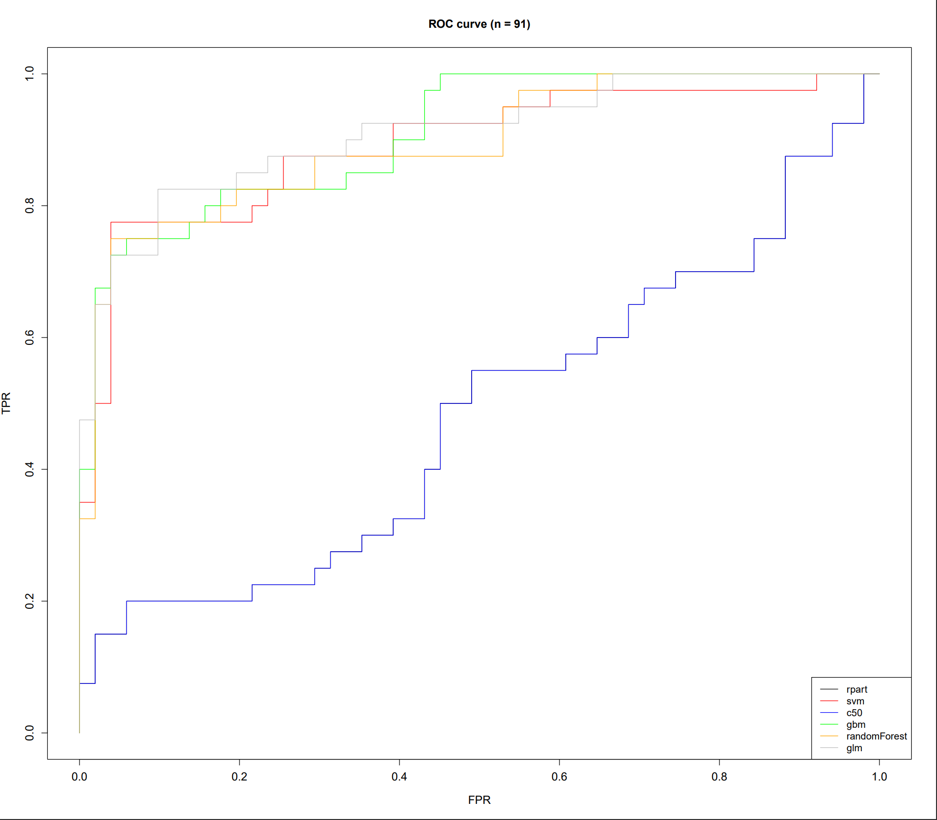
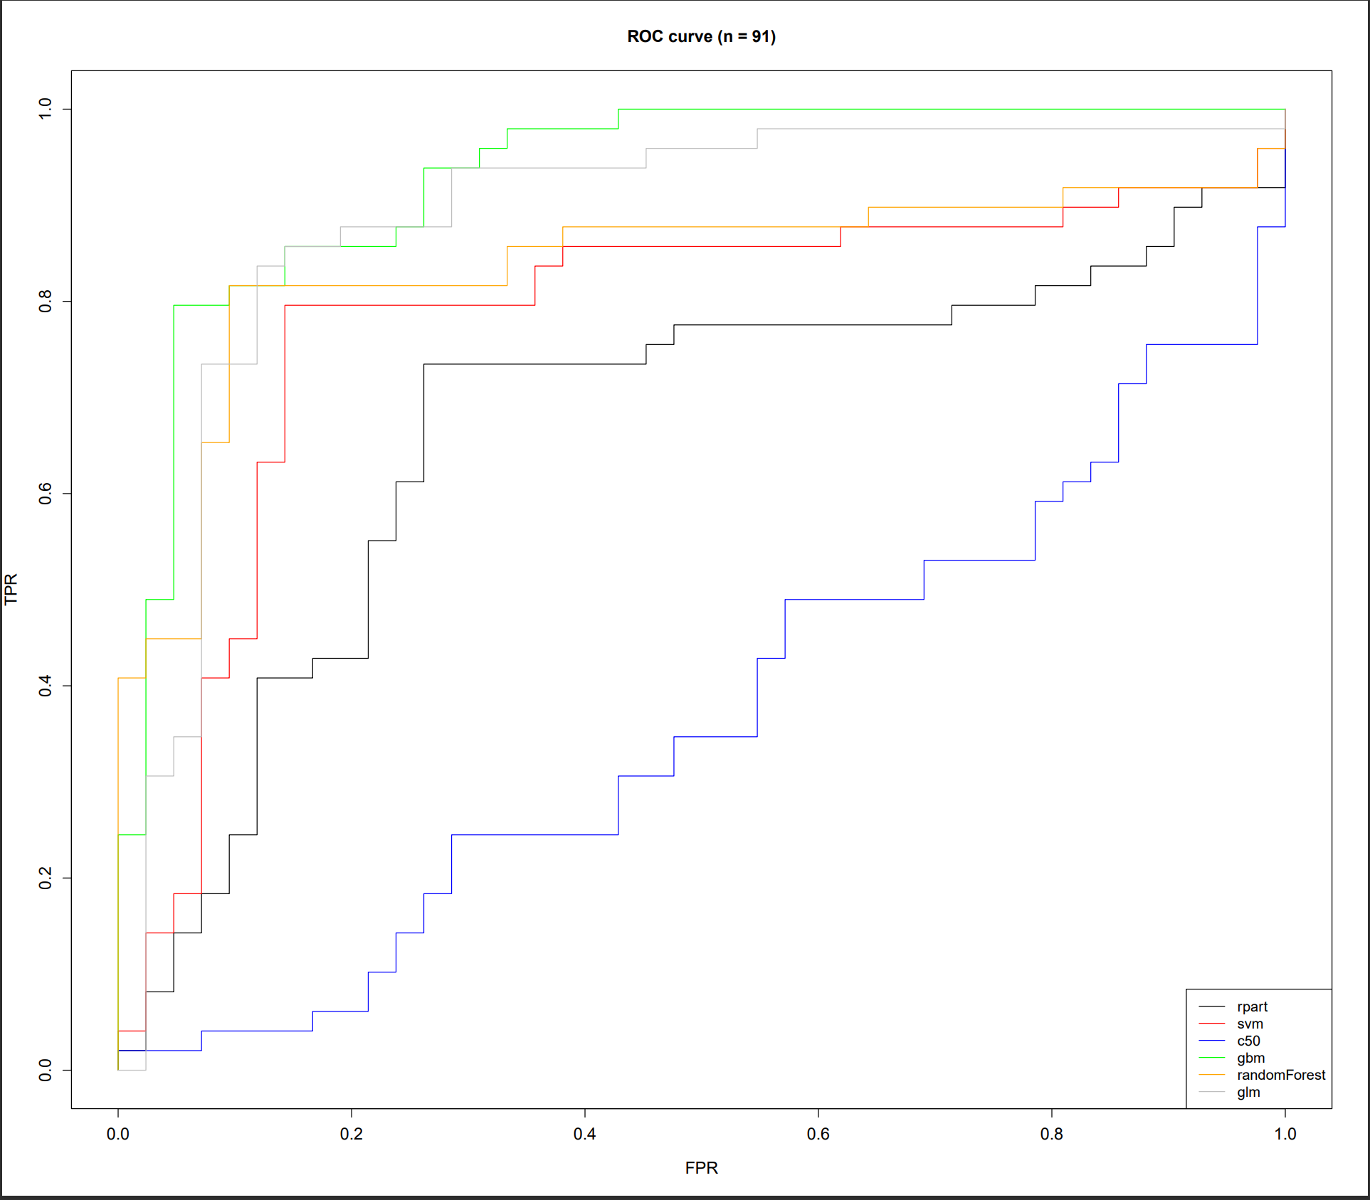
ROC Curves – Cleveland data set
Normal Run
CV Run

Slide 13
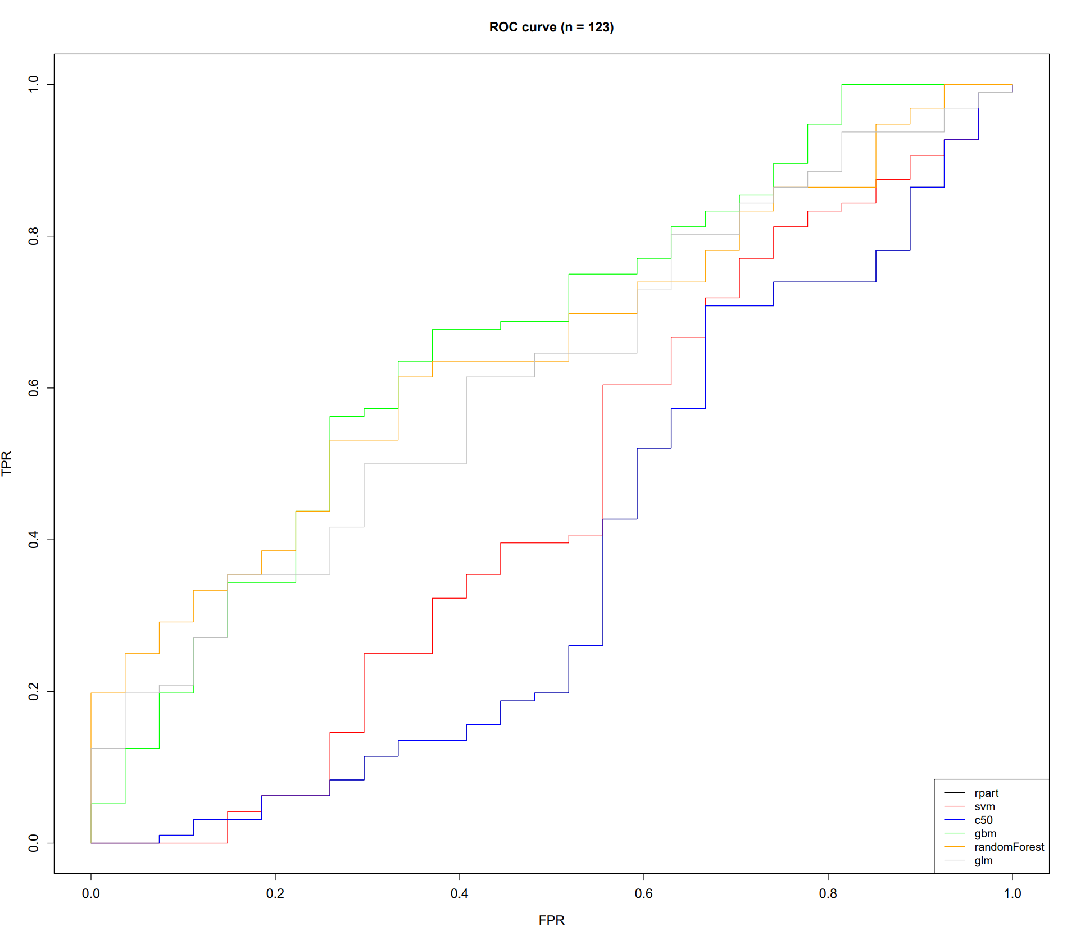
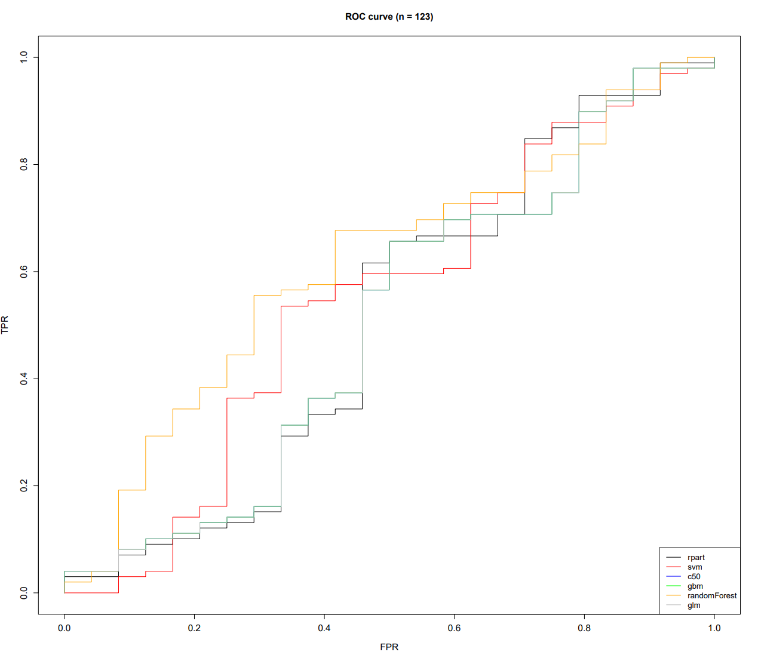
ROC Curves – Vegas data set
Normal Run
CV Run

Slide 14
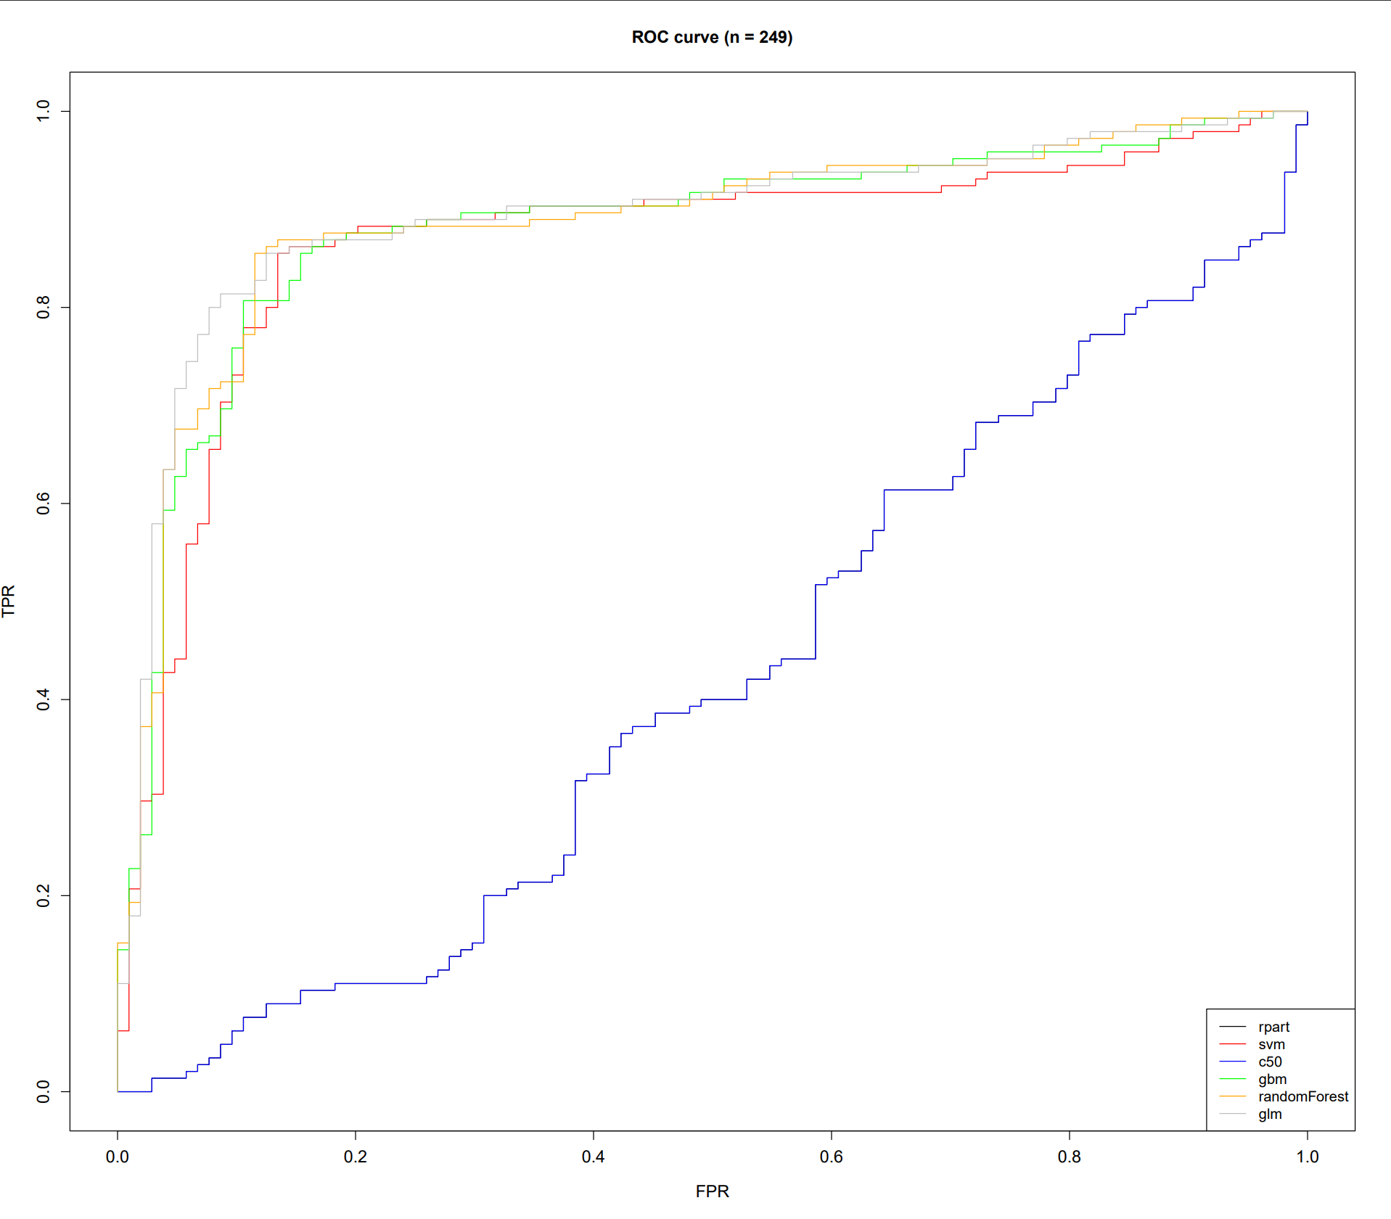
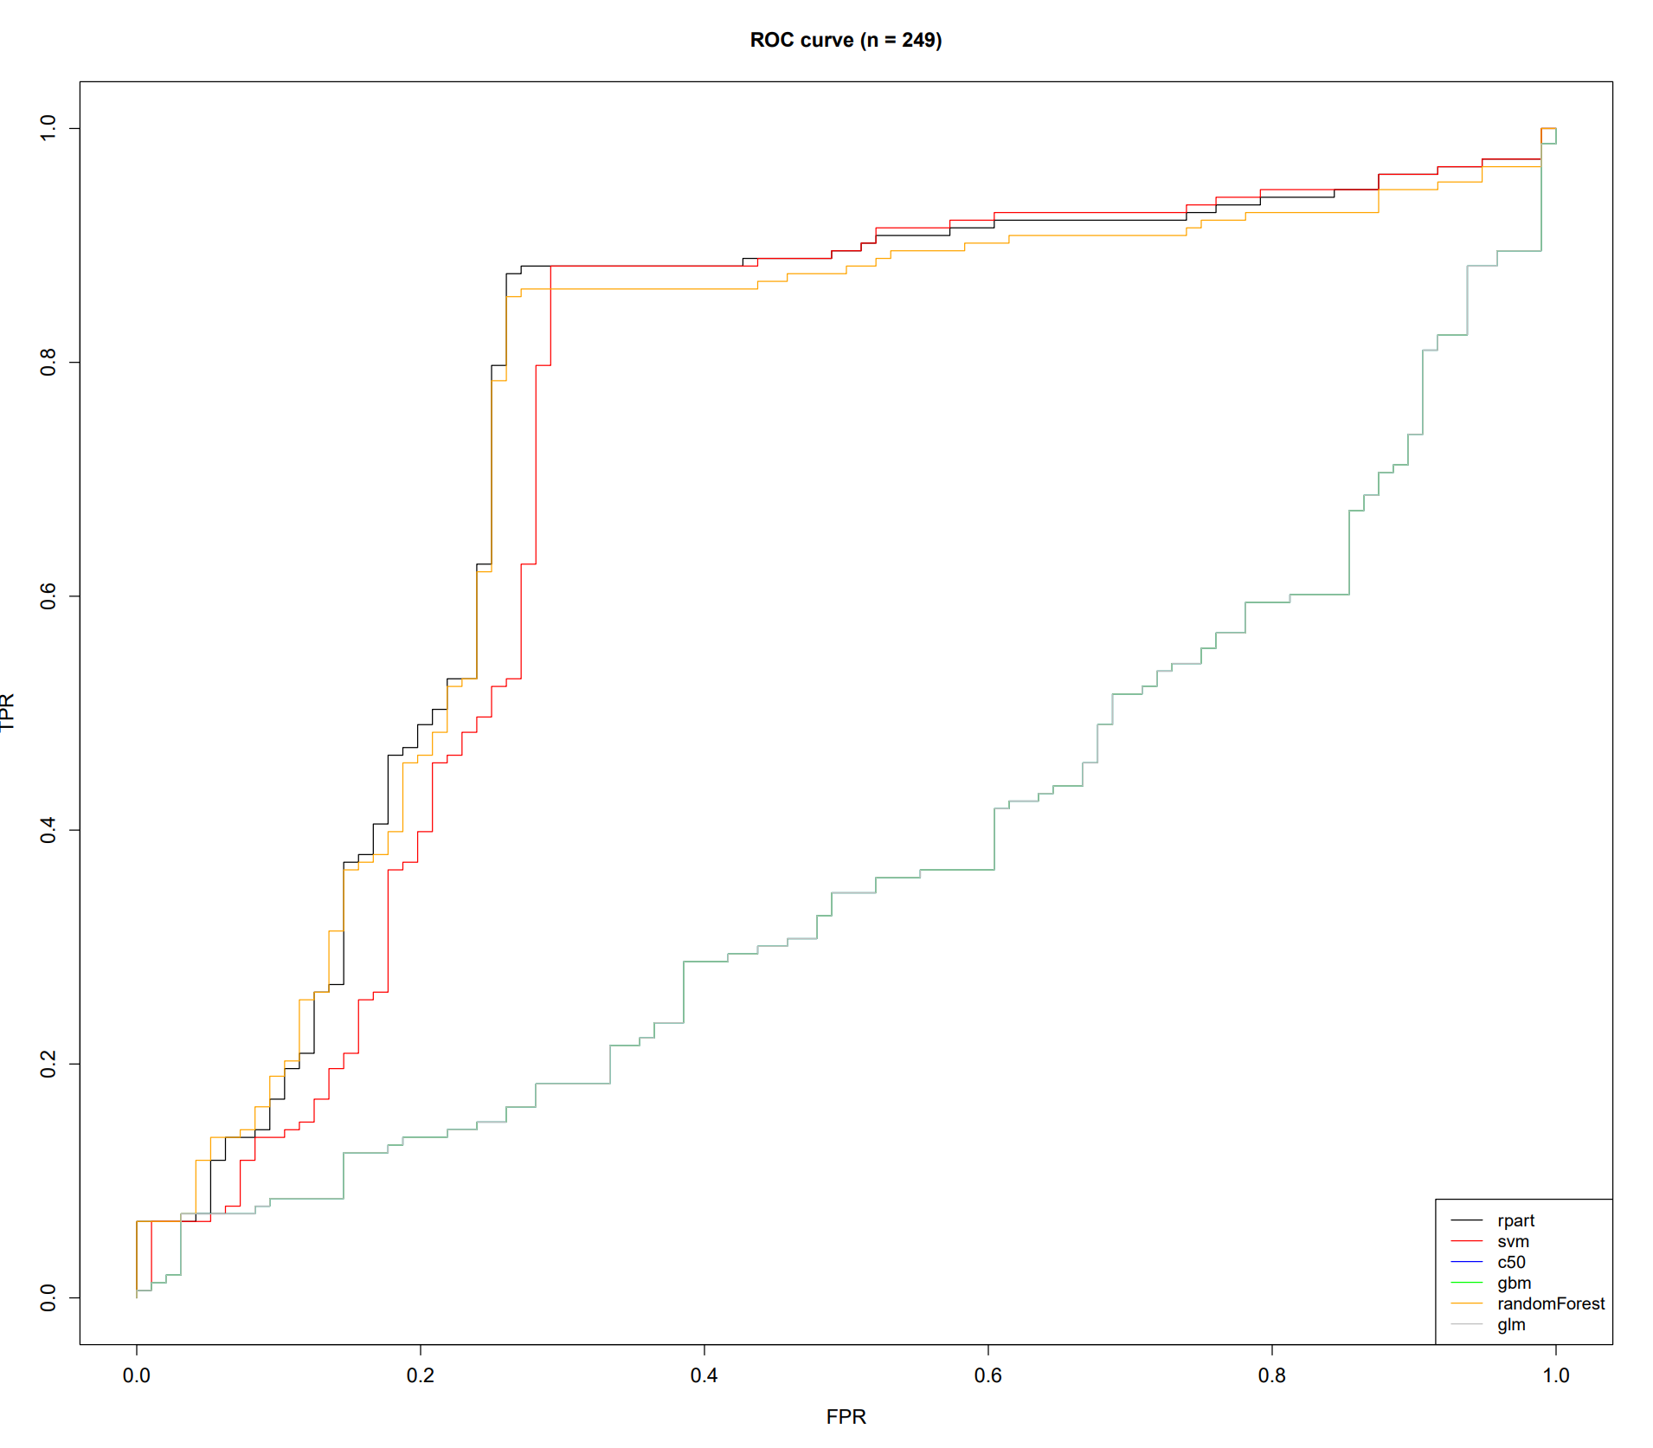
ROC Curves – Mammographic data set
Normal Run
CV Run

Slide 15
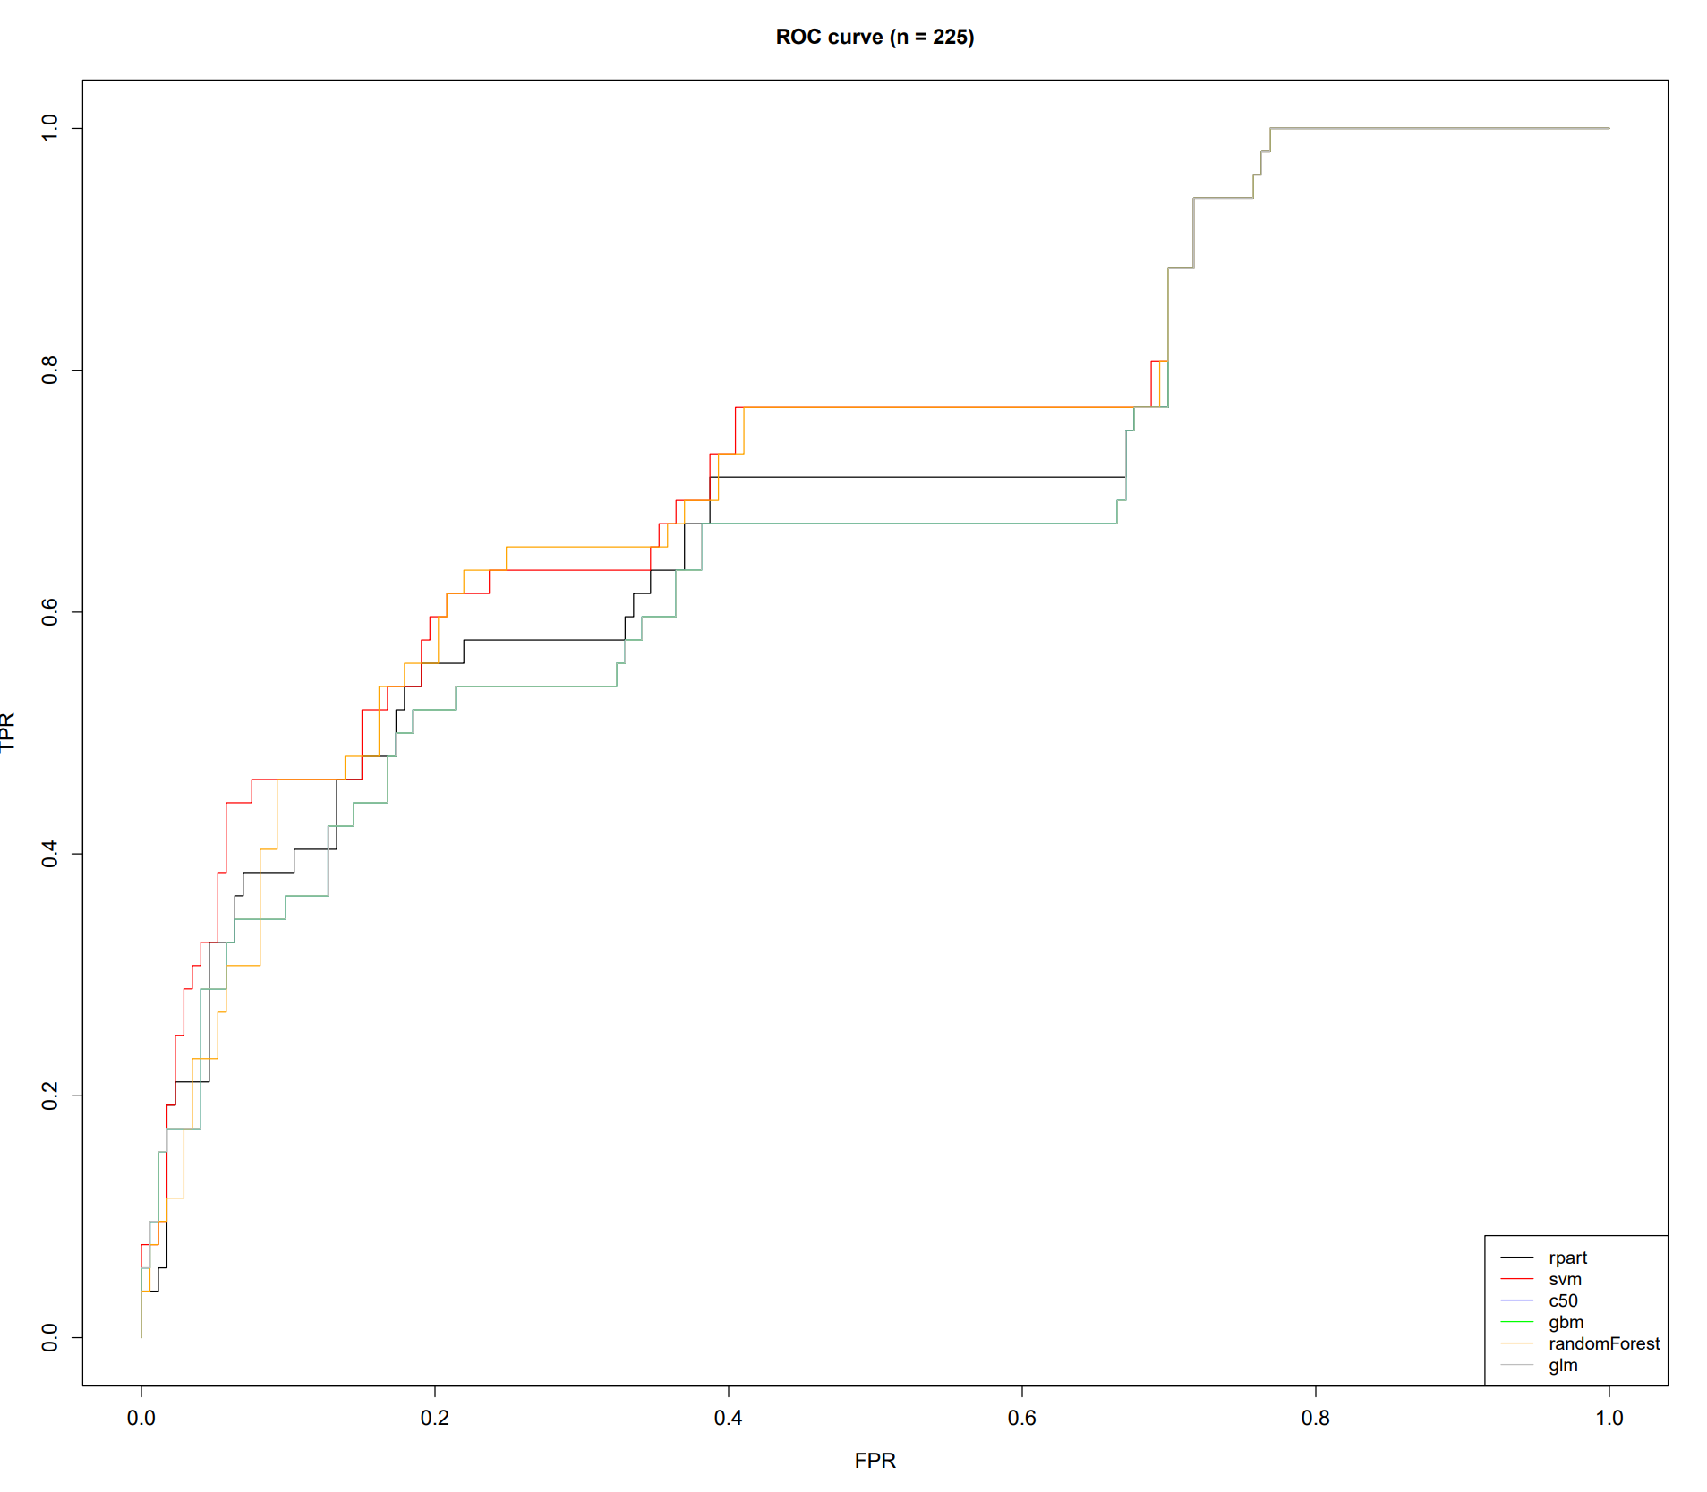
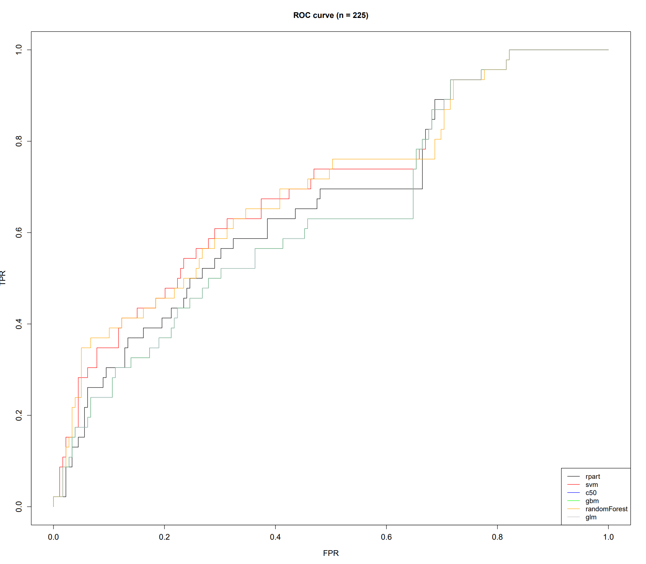
ROC Curves – Donation data set
Normal Run
CV Run

Slide 16
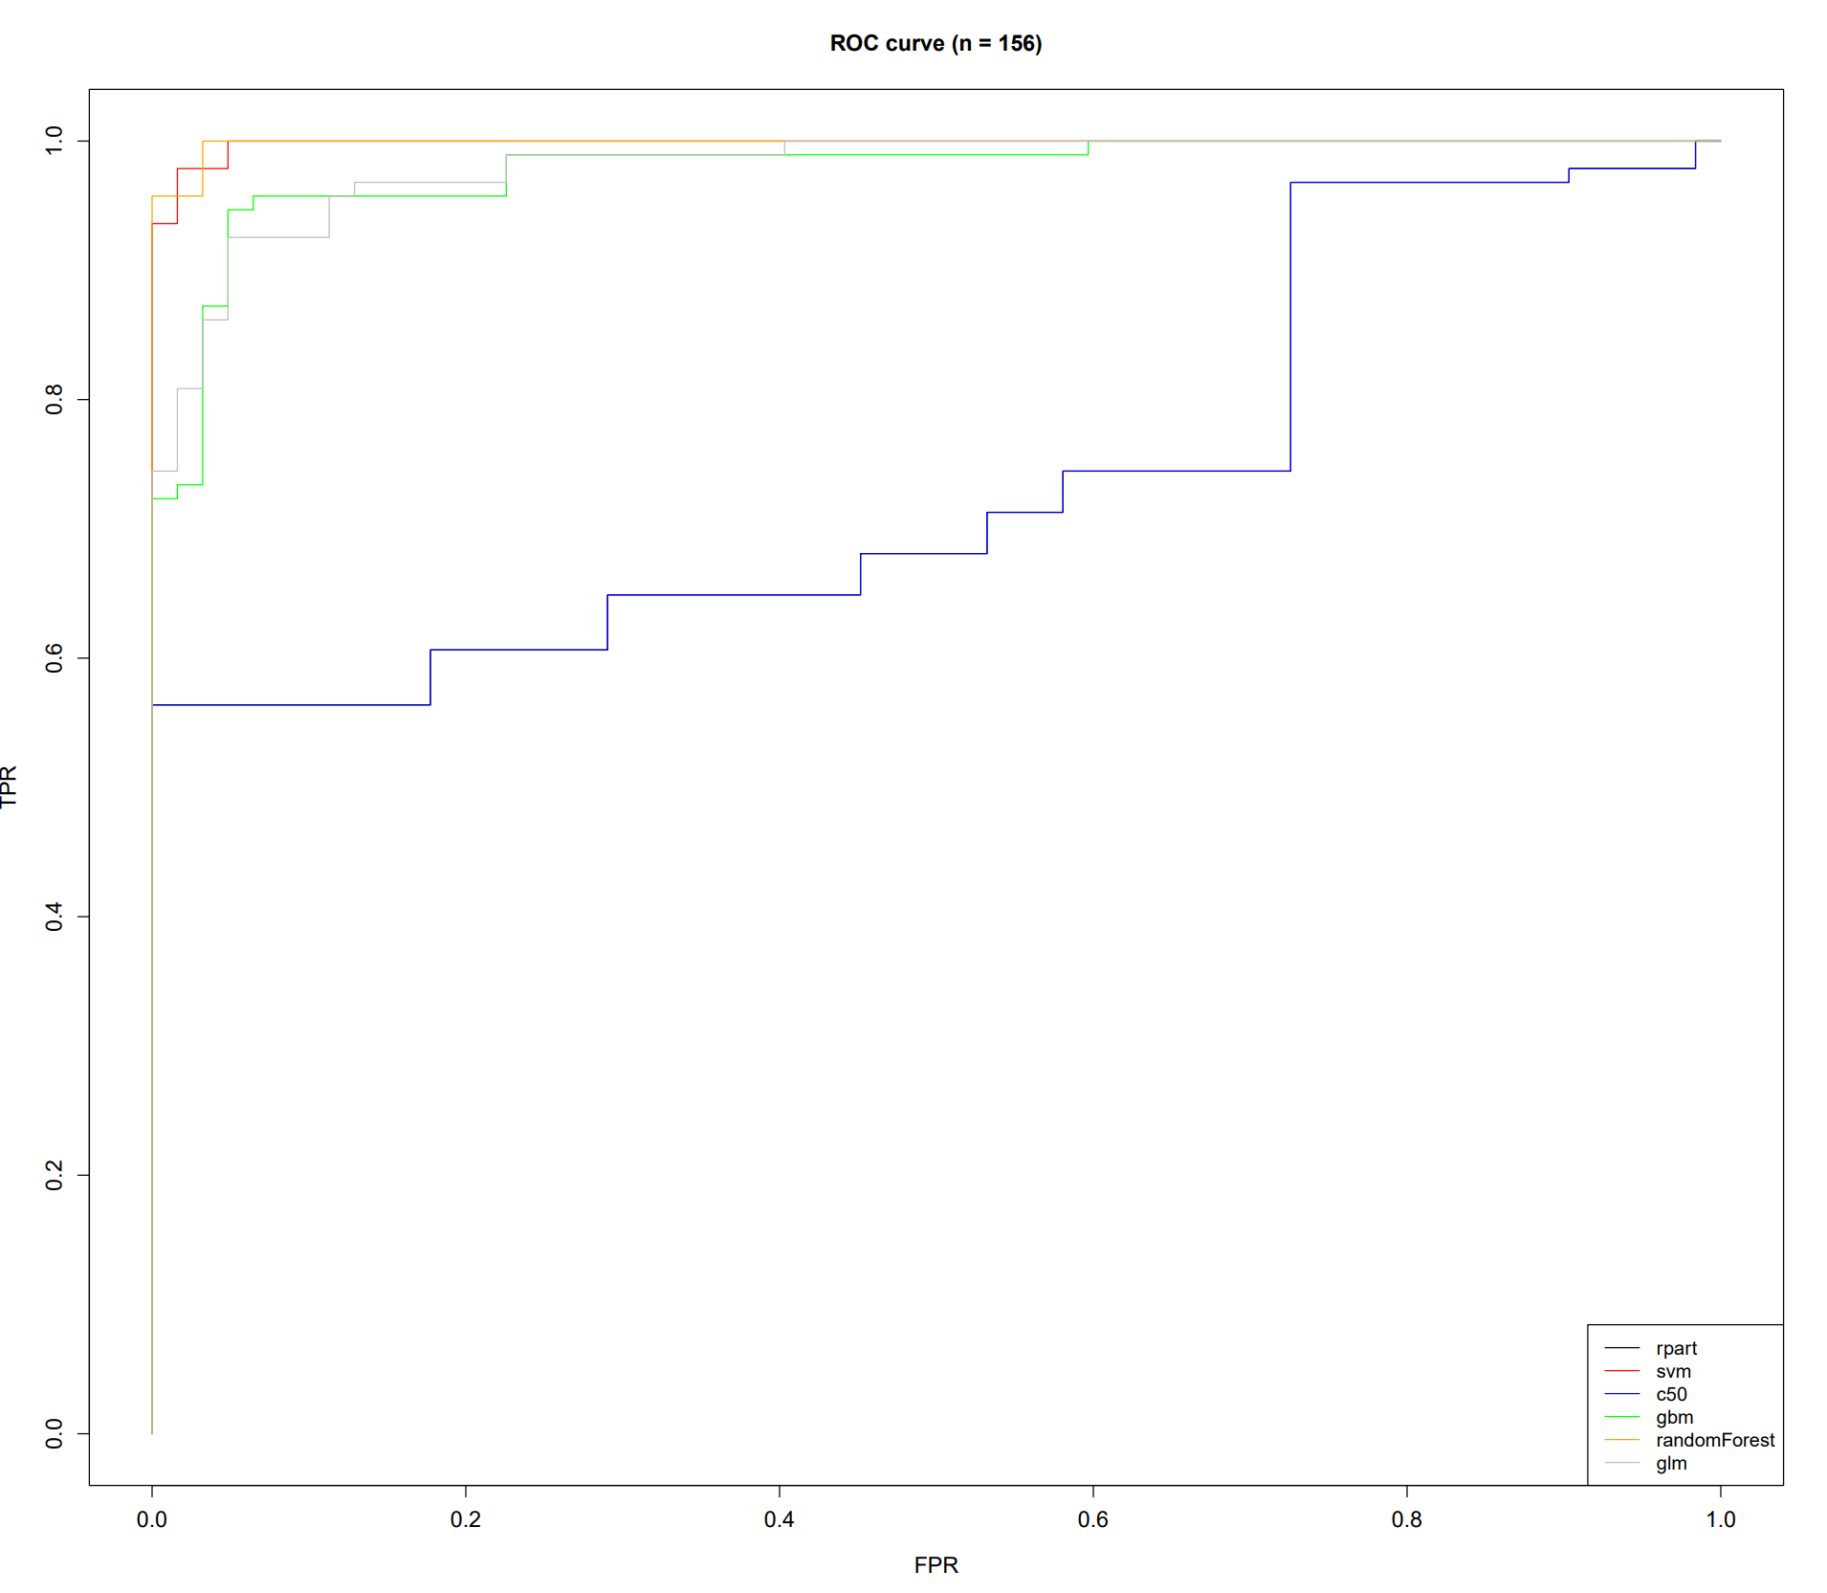
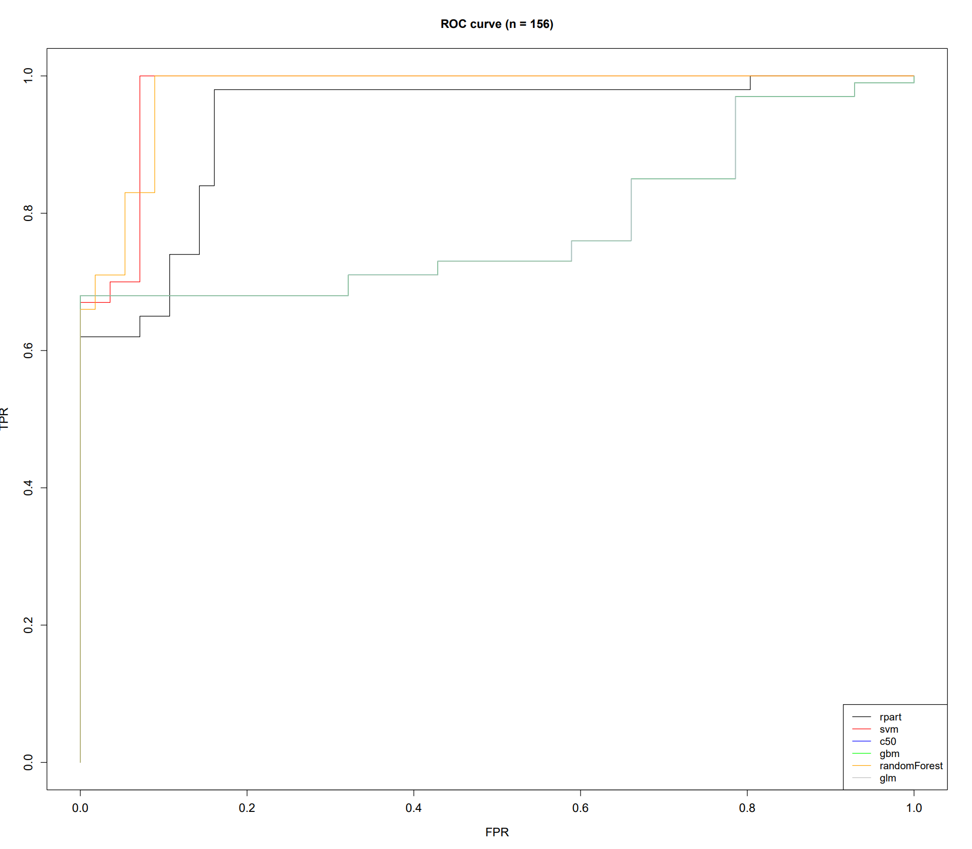
ROC Curves – Diabetes data set
Normal Run
CV Run

Slide 17
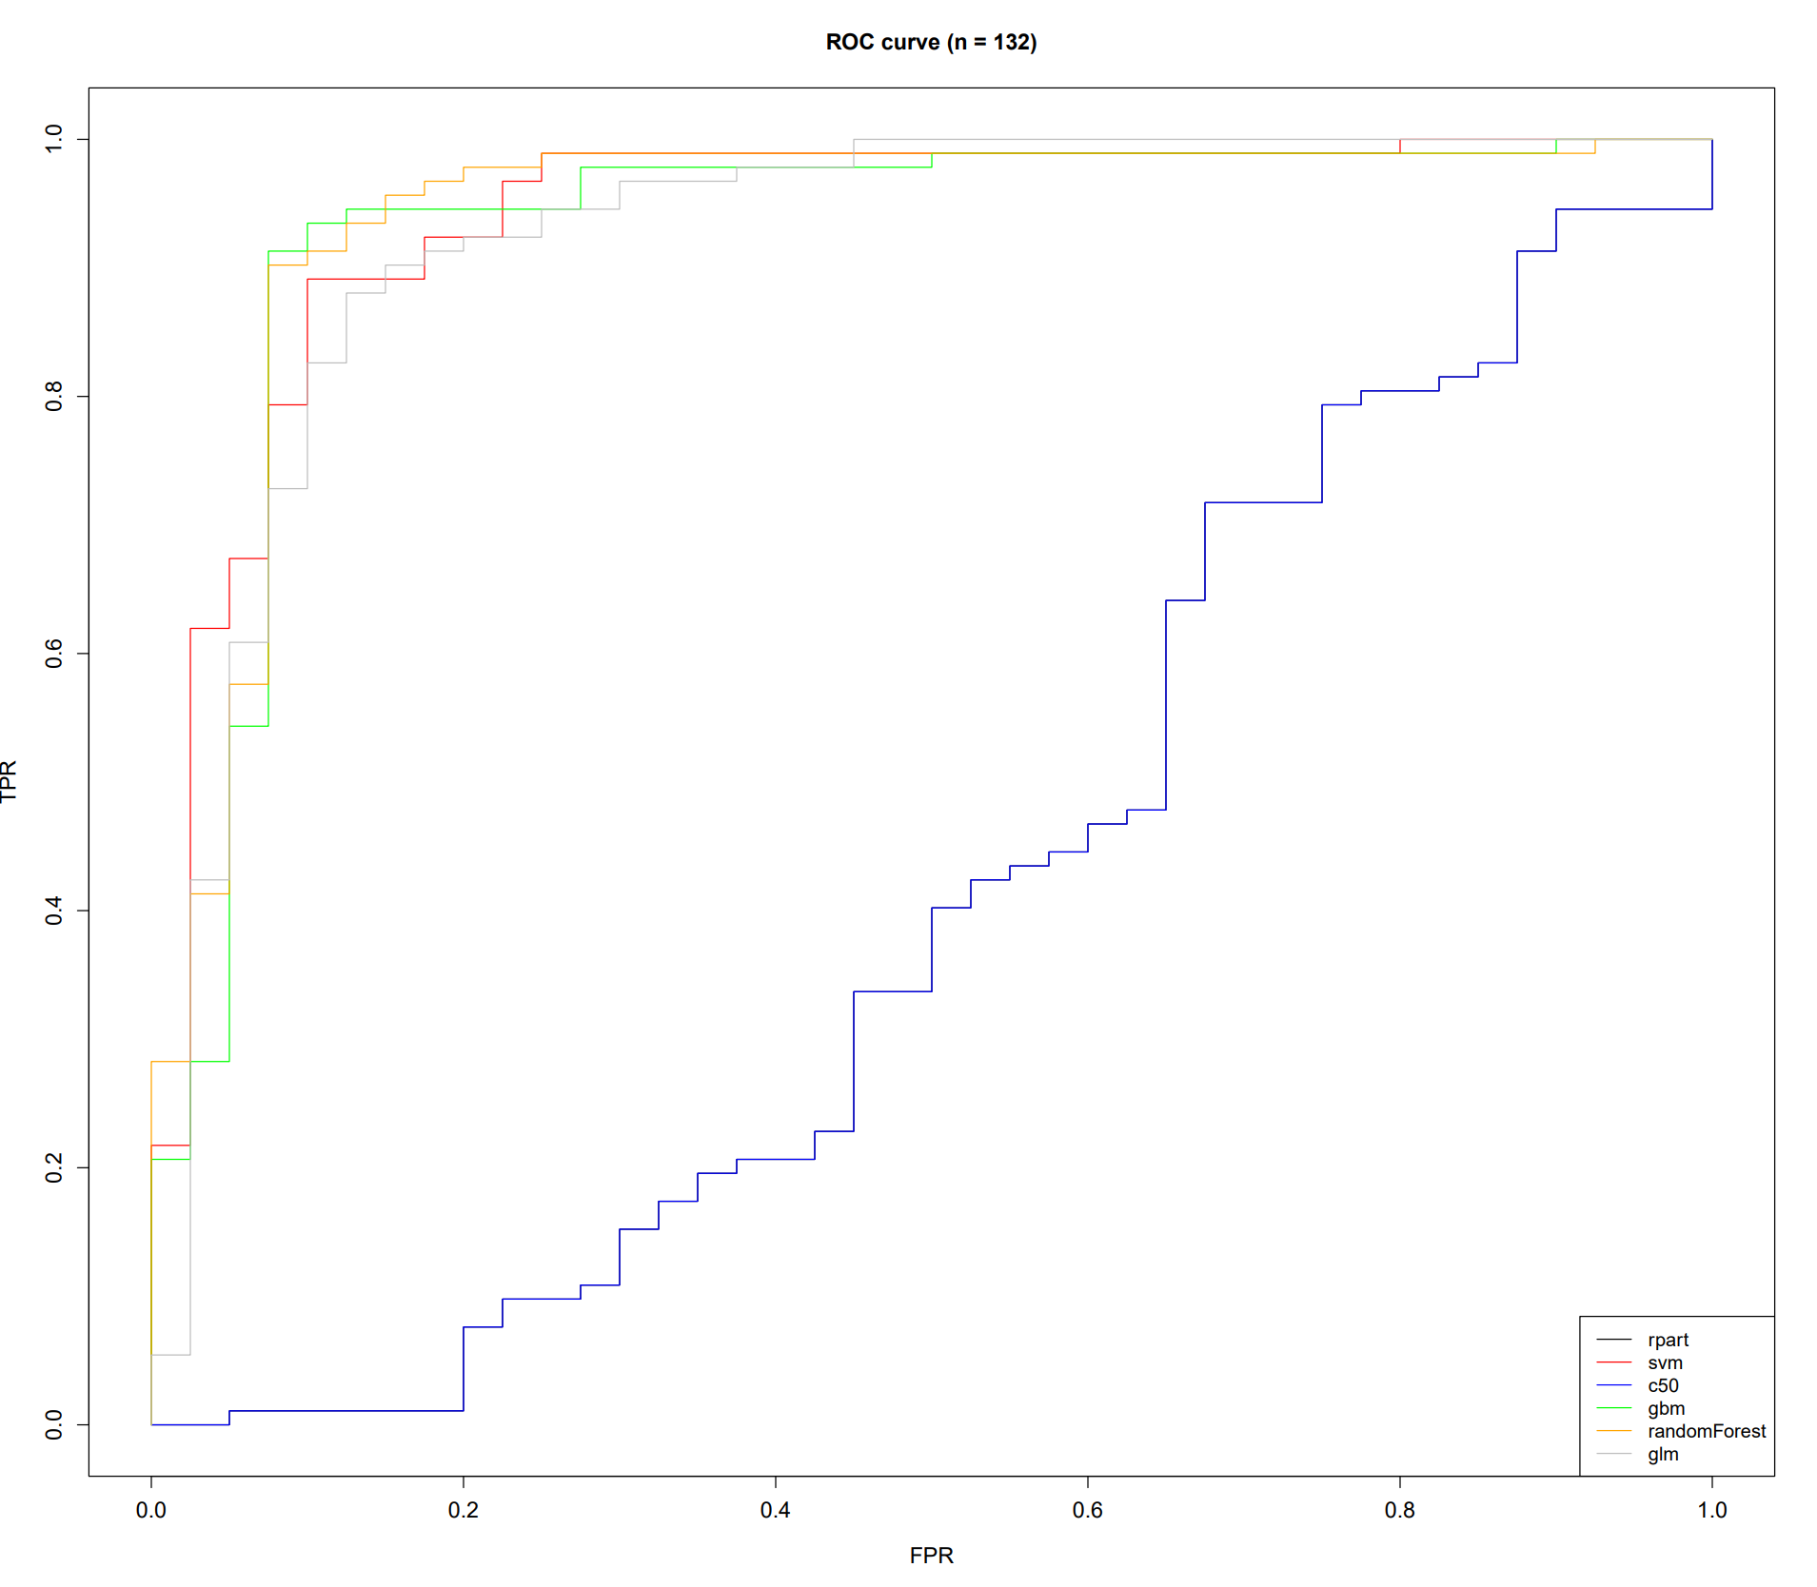
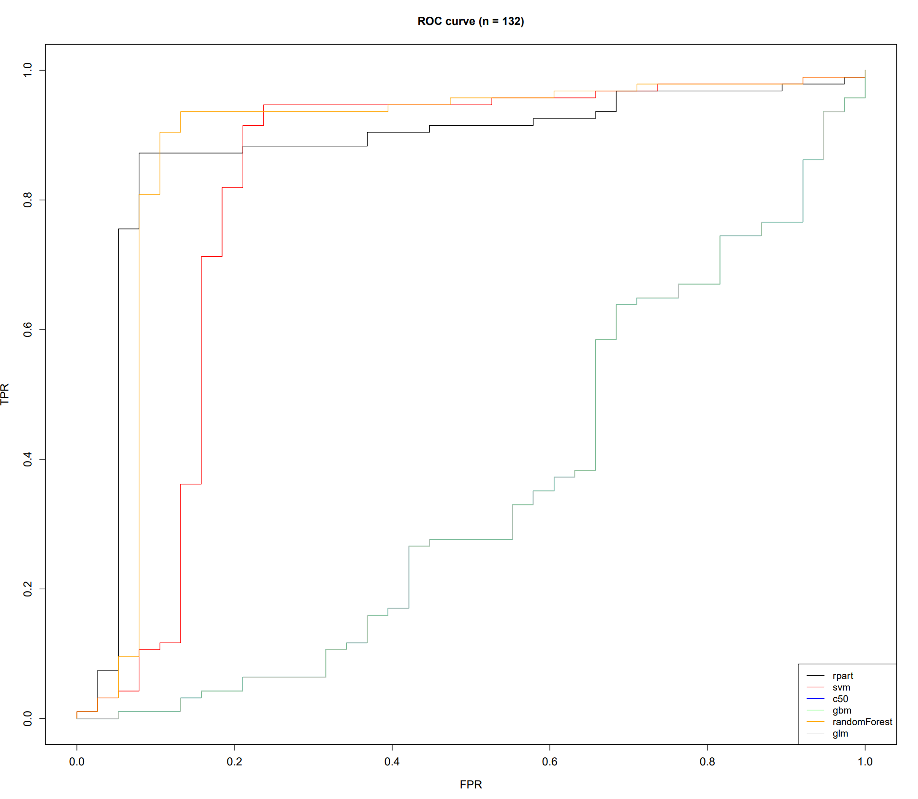
ROC Curves – Wholesale data set
Normal Run
CV Run

Slide 18
Conclusions
Make sure to pick the right model for the data, i.e., some models performed better with some datasets
Feature selection is very important, using all of the features may have reduced accuracy
Cross validation may take longer, but it can usually lead to better results as the most optimal parameters are used
There can be trade offs between accuracy and other goals, you need to select which is most important for you
Trying to force datasets that have multiple target classes into binomial datasets can lead to reductions in accuracy or other goals
Overall, pre-processing the data to best suit your model is a crucial step in the process. Making sure you have the most relevant features selected, and the data targets in a specific form will be better than selecting a certain model for the data. Even after the data has been processed, trial and error may still be necessary in model selection

